Slide 1
Traffic Management System
INTRODUCTION
One of the major problems faced in any metro city is traffic congestion.
Heavy traffic is a headache for each and every person driving the vechicles
and even to the traffic police in controlling the traffic.
Traffic congections has a negative impact on economy, the environment and the overall quality of life.
There are two ways through which traffic is been controlled
1)Manually
2)Systematically(controllers).
However the whole idea of a fixed time traffic light controller is not convenient for cities where traffic flow is variable.
For this reason a dynamic traffic control system is need, which controls the traffic signals according to the density of traffic.
In our project we focus on optimization of traffic light using IR sensor & Arduino UNO as a microcontroller.
In our project our approach is to take data/input from IR sensor it will allows us to detect whether the road is congested or not & will allows us to manage our traffic according to our input.

Slide 2
WORKING
This project works on the principle that when a car passes between the IR transmitter & IR receiver , the IR light is blocked and as the result the resistance of the photodiode increases, this change in resistance is converted to electrical pulse, which is used to control traffic lights.
COMPONENTS USED
Arduino UNO
IR sensors(IR transmitter & receiver)
LED’S(12)
Resistors(1k ohm)
Power supply(5v)
Jumping wires

Slide 3
BLOCK DIAGRAM
IR MODULE
Micro controller
LED’S
Power supply

Slide 4
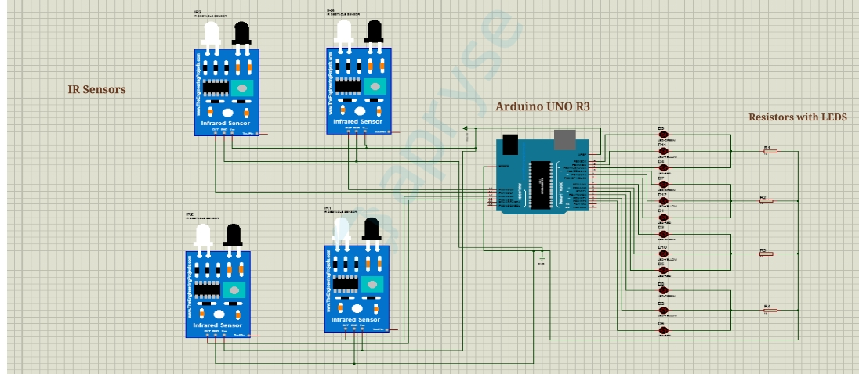
CIRCUIT DIAGRAM

Slide 5
CONCLUSION & FUTURE WORK
In this project we have studied the optimization of traffic light light controller in a city using IR sensor & microcontroller. By using this system we tried to reduce the possibilities of traffic jams, caused by traffic light and we have successfully get the result. Number of passing vehicle in fixed time slot on the decide the density range of traffic and on basis of vehicle count microcontroller decide the traffic light delays for next recording interval.
The proposed work in this project is to eliminate the traffic congestion problem but still a lot of work can be done on this project or on the other traffic problems.
Improve in this project
1)we can use RFID tags instead of IR sensors as there range is limited so we can use RFID system
2)we can yse different micro controllers(Raspberry Pi,PIC controller)
3)we can make a system for pedestrian path along with this project as well.
4)we can make a signal free system for ambulance.
5)we can attach LCDs with signals with following information .

